Slide 1

Medical Text Classification
Aswin V T 23BM6JP14

Slide 2
Process Overview
Input data
Clinical notes
Classification model
Pipeline
Output class
Medical speciality
Medical data pre-trained NLP model

Slide 3
Medical Transcription Dataset
The data set contains sample medical transcriptions for various medical specialities.
Data was scraped from mtsamples.com
Data size is around 5000

Slide 4
Pipeline Structure
Data Pre-Processing
Vectorisation
Feature Extraction
Visualisation
Dimensionality Reduction
ML Classifier

Slide 5
Data Pre-Processing
Data Cleaning
Text Analysis:
Whitespace Removal
Category Merging (similar category)
Final Data Preparation
Data Filtering (entry count)
Data Grouping (by medical speciality)
Specific Category Filtering

Slide 6
Relevant Feature extraction
Lemmatization: The lemmatize_text() function is defined to lemmatize the input text. This is done using the WordNetLemmatizer from the nltk library.
Text Cleaning: The clean_text() function is defined as cleaning the input text.
NER Model: Loaded the en_ner_bionlp13cg_md model from sci-spacy, which is trained on BIONLP13CG corpus

Slide 7
Vectorization
TF-IDF vectorization of entities with 1000 features.
Vectorization using pre-trained Biowordvec embeddings of 200 dimensions trained using PubMed and MIMIC III clinical notes.

Slide 8
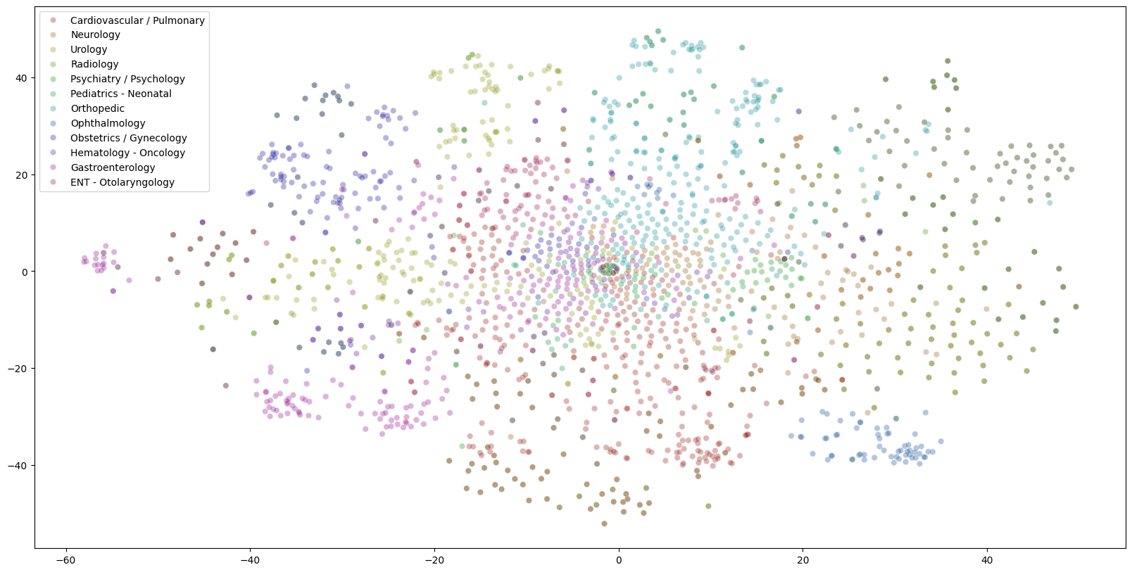
Visualization
Clinical text data in 2D using t-SNE.

Slide 9
Dimensionality Reduction PCA
PCA (Principal Component Analysis):
Applied PCA to reduce the dimensionality of feature space from 1000 to 582.
Retained 95% variance in the data.

Slide 10
ML Classification Algorithm
1. Logistic Regression
1A. Normal
1B. Smoothened
2A. Bagging
2B. Boosting
2. Random Forest
3. Support Vector Machine

Slide 11
1A. Multi-Class Logistic Regression with regularisation
Model: Logistic Regression with elastic net regularization.
Penalty: Elasticnet
Solver: SAGA
L1 Ratio: 0.5
Random State: 1
Avoid multicollinearity
Improve generalization performance by reducing the variance

Slide 12
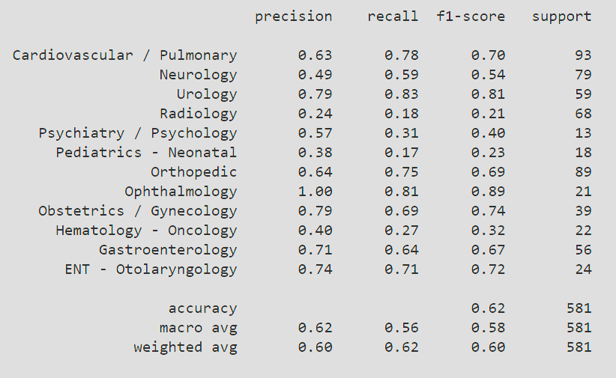
1. Classification Report

Slide 13
Logistic Regression with Smoothening
Addressing Class Imbalance
SMOTE (Synthetic Minority Over-sampling Technique),Oversample the minority class (underrepresented medical specialties).
Create synthetic samples to balance the dataset by using PCA component of minority classes.

Slide 14
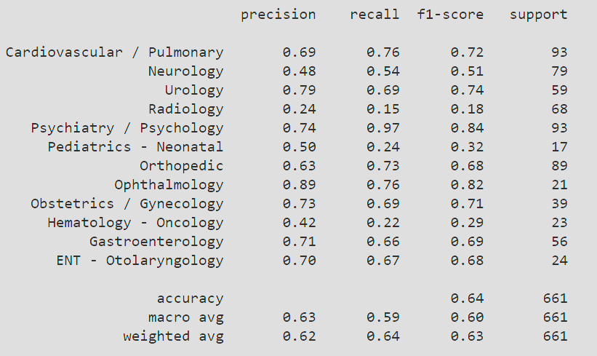
1B. Classification Report Logistic Regression with Smoothening

Slide 15
2A. Random Forest With Bagging
Base estimator: Random forest (num of tress =100)
Ensemble method used: Bagging classifier (num of base estimators = 50)

Slide 16
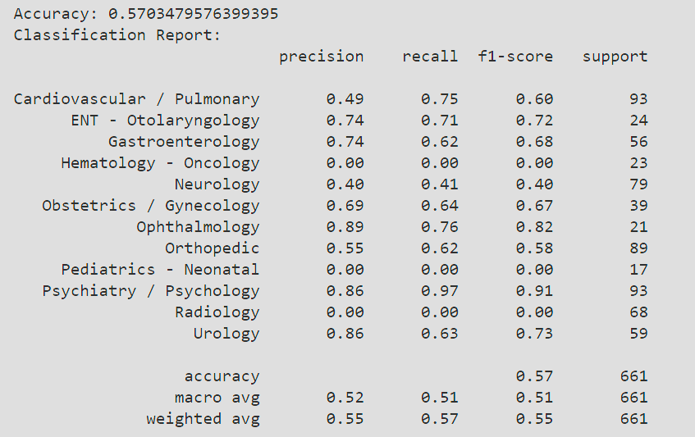
2A. Classification Report – Random Forest - Bagging

Slide 17
2B. Random Forest With Boosting(AdaBoost)
Base estimator: Random forest (num of tress =100)
Ensemble method used: Baggingclassifier
(no. of base estimators = 50)

Slide 18
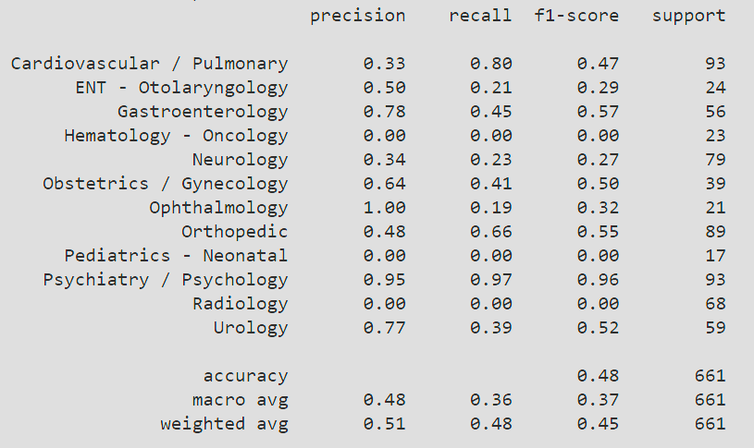
2B. Classification Report – Random Forest - Boosting

Slide 19
3. Support Vector Classification with grid search
Applied SVM classifier with grid-search based hyper parameter tuning
Kernel functions used : RBF, Linear
Kernel coefficient: 0.1, 0.01,0.001
Regularization parameter: 0.1,1,10
Best Hyperparameters
C: 1
gamma: 0.1
kernel: ‘rbf’
Accuracy: 0.65

Slide 20
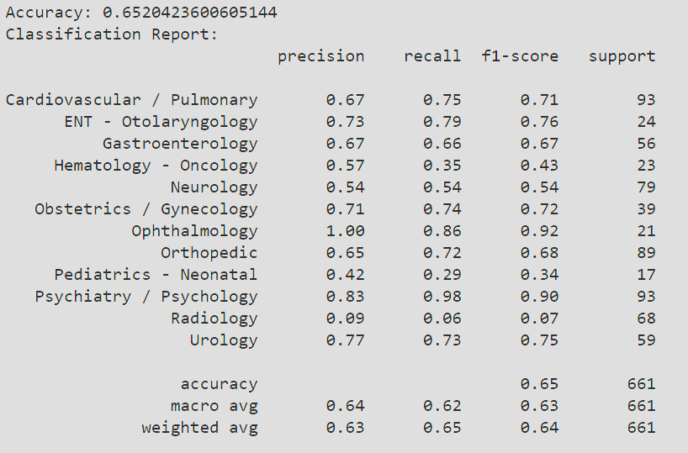
3. Classification Report SVM

Slide 21
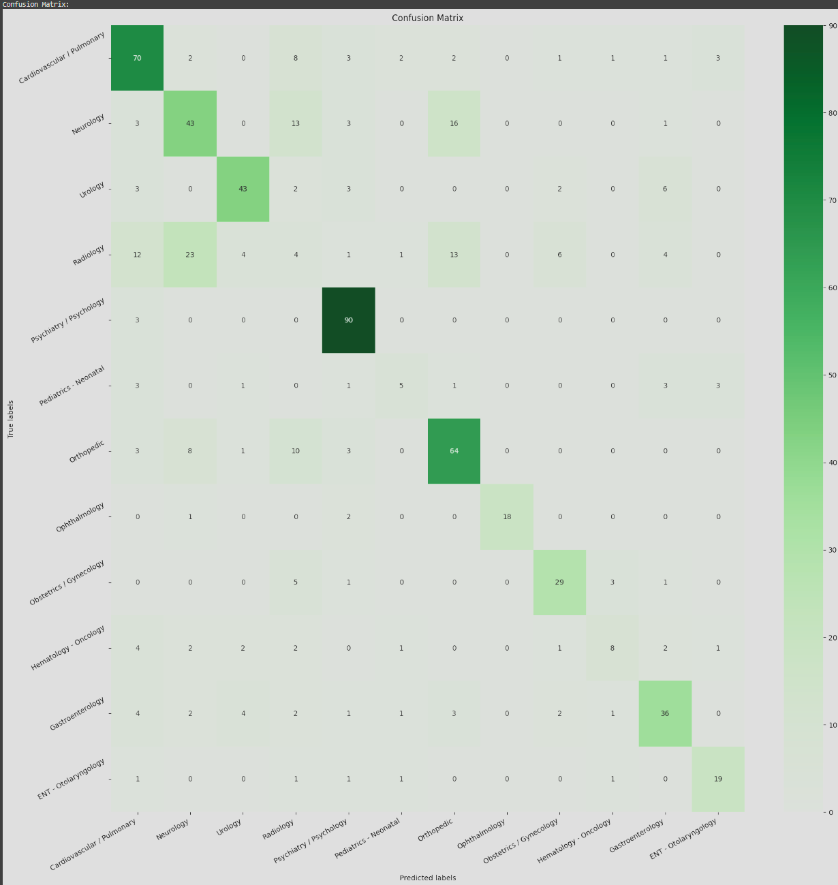
Confusion Matrix based on SVM classifier

Slide 22
Result Analysis
It is observable from the confusion matrix that the model performed decently for most of the classes except 'Radiology', 'Pediatrics – Neonatal’,
This happens because the NER model we used for entity recognition was trained on medical data, which has less chance of capturing terms related to those classes mentioned above.
Performance could be improved by fine-tuning the NER model on data related to those domains.

Slide 23
Application
Automatically categorize and organize clinical notes, within EHR systems
Clinical Decision Support Systems (along with information extraction techniques)
Clinical Research and Literature Mining( classification based on medical specialization/research topic)

Slide 24

Thank You

